Slide 1
DATA SCIENCE PROJECT PRESENTATION
Presented by: Aanchal Soni

Slide 2

Data Science Project
Prediction of a chronic diseases “Diabetes” using a model with higher accuracy

Slide 3
Overview on the chronic diseases “Diabetes” and this project
Diabetes is an illness caused because of high glucose level in a human body.
Diabetes should not be ignored if it is untreated then Diabetes may cause some major issues in a person like: heart related problems, kidney problem, blood pressure, eye damage and it can also affects other organs of human body.
Diabetes can be controlled if it is predicted earlier. To achieve this goal this project work we will do early prediction of Diabetes in a human body or a patient for a higher accuracy through applying, Various Machine Learning Techniques.
Machine learning techniques Provide better result for prediction by constructing models from datasets collected from patients.
The Project work gives the accurate or higher accuracy model shows that the model is capable of predicting diabetes effectively.

Slide 4
Softwares: Jupyter Notebook through Anaconda Navigator
Libraries:
NumPy
Pandas
Matplotlib
Seaborn
Skit-learn (sklearn)
Dataset: Kaggle- PIMA Indian diabetes dataset
Programming Language:
Python

Slide 5
Data Set
Data Preprocessing
WORKFLOW OF THE MODEL
Data Splitting
Test Data
Training Data
KNN
Applying classifiers
SVM
Performance Evaluation
NB
RF
Output Prediction

Slide 6
1. K-Nearest Neighbor(KNN) 2. Support Vector Method 3. Naive Bayes 4. Random Forest
Parameters affecting diabetes
Pregnancies
Glucose
Blood Pressure
Skin Thickness
Insulin
BMI
Diabetes Pedigree Function
Age
Algorithms used for diabetes prediction

Slide 7


Algorithm-1 Support Vector Method
Svm (supervised machine learning algorithm) creates a hyperplane that separate two classes. It can create a hyperplane or set of hyperplane in high dimensional space.

Slide 8
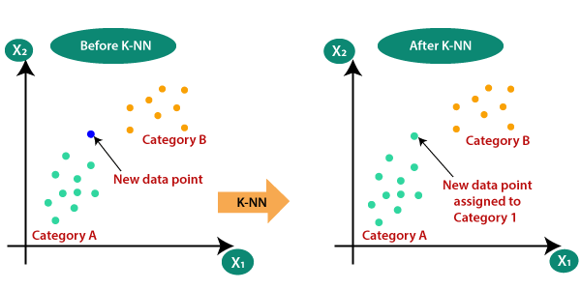
Algorithm-2 K-Nearest Neighbor(KNN) Algorithm
Euclidean distance formula is used in this supervised machine learning algorithm for finding the data nearest to the available categories.

Slide 9
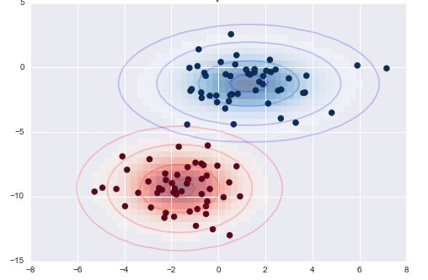
Algorithm-3 Naive Bayes Algorithm
It is a classification technique based on Bayes' Theorem with an assumption of independence among predictors i.e., a Naive Bayes classifier assumes that the presence of a particular feature in a class is unrelated to the presence of any other feature

Slide 10
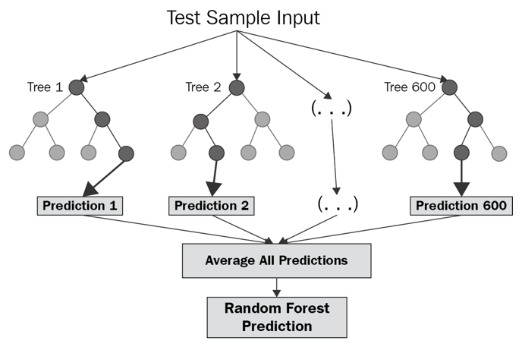
Algorithm-4 Random Forest Algorithm
The random forest is a classification algorithm consisting of many decisions trees. It uses bagging and feature randomness when building each individual tree to try to create an uncorrelated forest of trees whose prediction by committee is more accurate than that of any individual tree.

Slide 11
CONCLUSION
The dataset consists of the record of 768 patients with the 8 parameters on which diabetes depends and the data states that the 500 people are non-diabetic and 168 people are diabetic.
The ML model KNN was able to classify patients as diabetic or not with an accuracy of 72.078%
The ML model RF was able to classify patients as diabetic or not with an accuracy of 74.025%
The ML model SVM and Naïve Bayes were able to classify patients as diabetic or not with an accuracy of 77.272%
The main aim of this project was to design and implement Diabetes Prediction Using Machine Learning Methods and Performance Analysis of that methods and it has been achieved successfully.

Slide 12
Accuracy Profile
77.272
PERCENTAGE ACCURACY on scale of 100
74.025
72.078
SVM
RF
NB
ALGORITHM
KNN

Slide 13
Thank You!

